Slide 1
ARTIFICIAL INTELLIGENCE
Explained with a human touch

Slide 2

Hello!
I AM HUSSAINA MUSTAFA
I am here to give an overview on Artificial Intelligence.

Slide 3
“A year spent in artificial intelligence is enough to make one believe in God.”
– Alan Perlis

Slide 4
What is AI and ML ?
1

Slide 5
Definition of Artificial Intelligence
Artificial intelligence (AI) broadly refers to any human-like behavior displayed by a machine or a system.
Definition of Machine Learning
Machine learning refers to the process by which computers develop pattern recognition, or the ability to continuously learn from and make predictions based on data, and can make adjustments without being specifically programmed to do so.
Notes:
Artificial intelligence refers to any human like behaviour

Slide 6
HISTORY,BRANCH AND APPLICATIONS

Slide 7
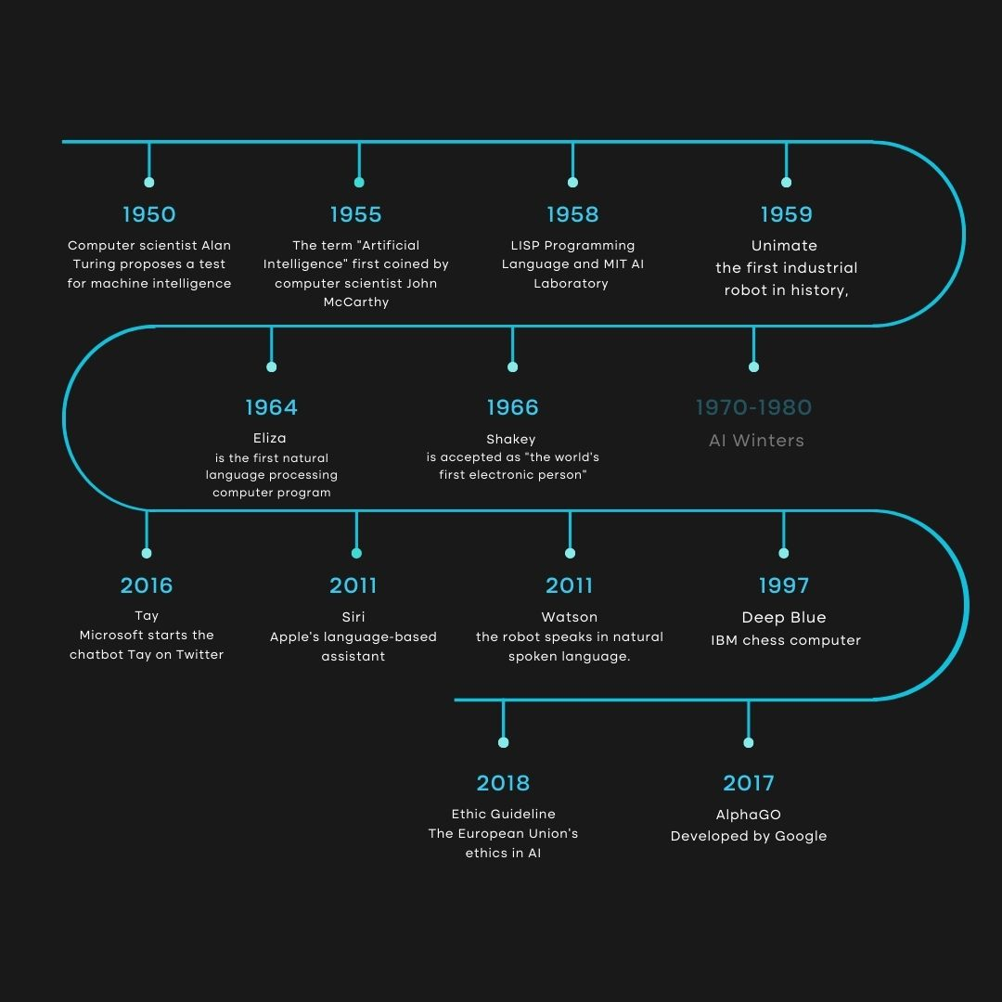

Slide 8
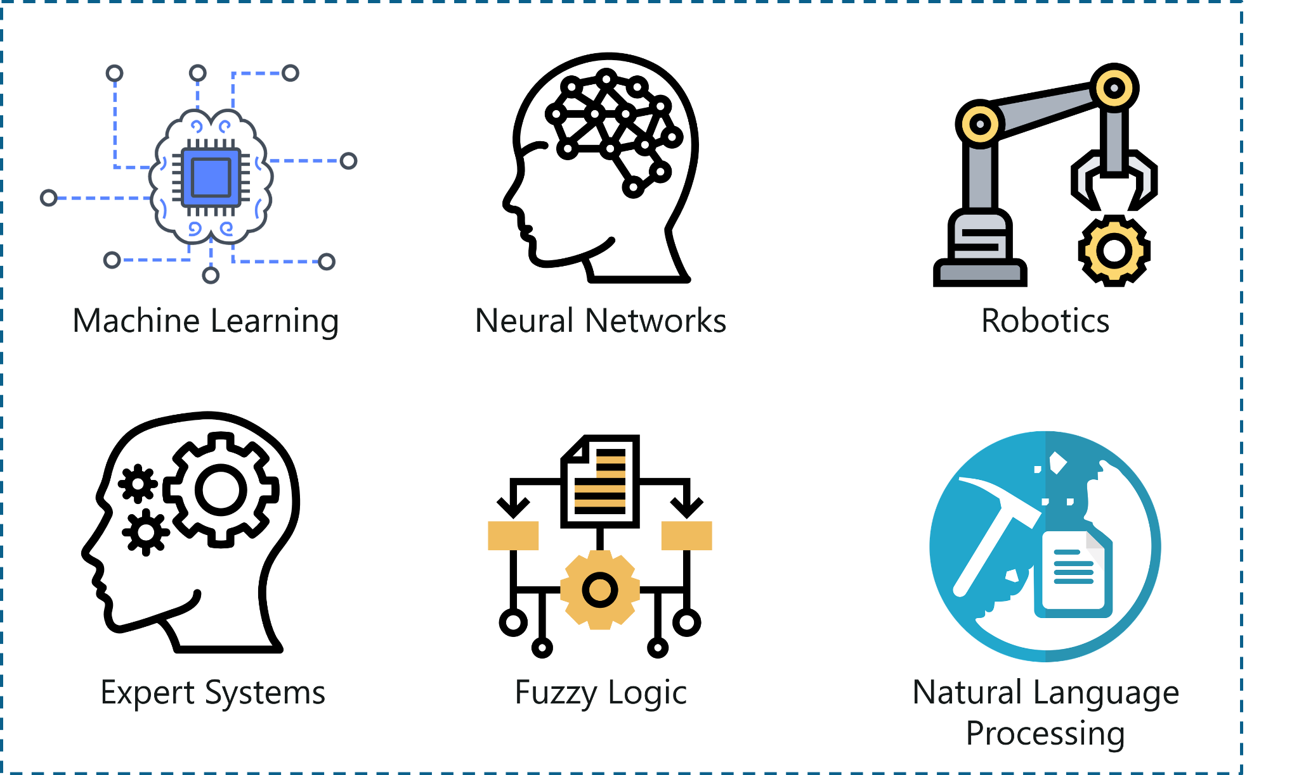

Slide 9
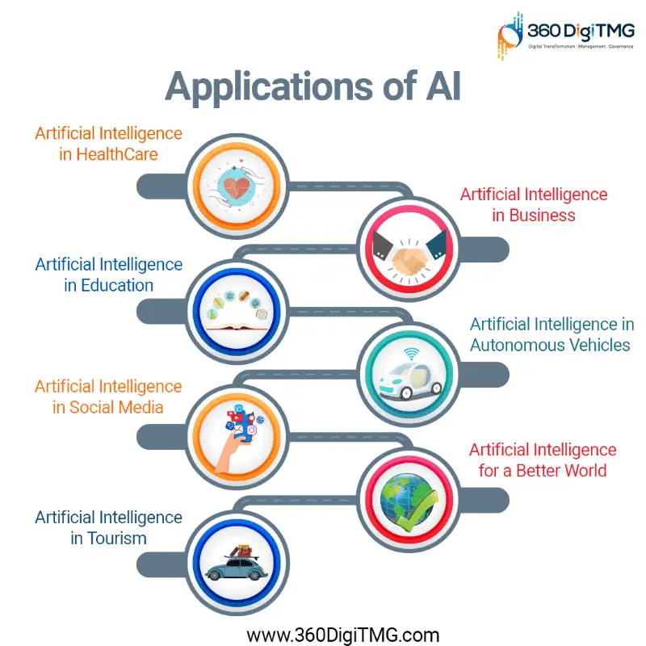

Slide 10
What is SL, UL and RL ?
2

Slide 11
Difference between SL, UL and RL
Supervised Learning
Input data is labelled.
Learn patterns of input and their labels.
Model is built and trained prior to testing.
Decision tree, linear regression
Unsupervised Learning
Input data is not labelled.
Divides data into classes.
Model is built and trained prior to testing.
K-means clustering, agglomerative clustering.
Reinforcement Learning
Input data is not predefined.
Finds the best reward between a start and an end state.
The model is trained and tested simultaneously.
Q-learning, Deep Q Network.

Slide 12
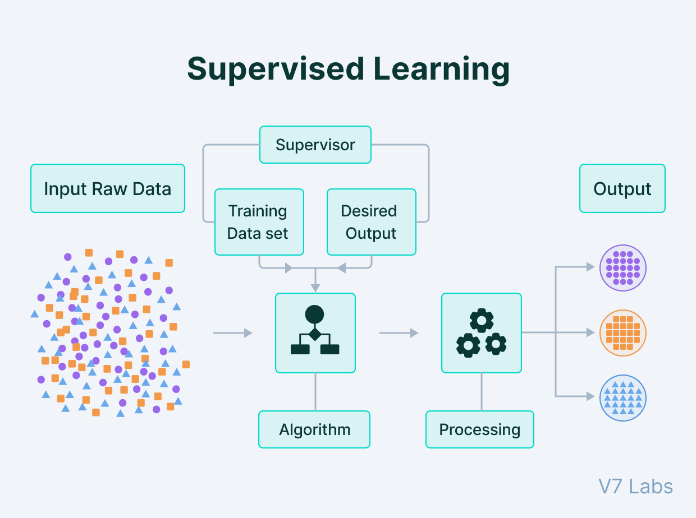

Slide 13
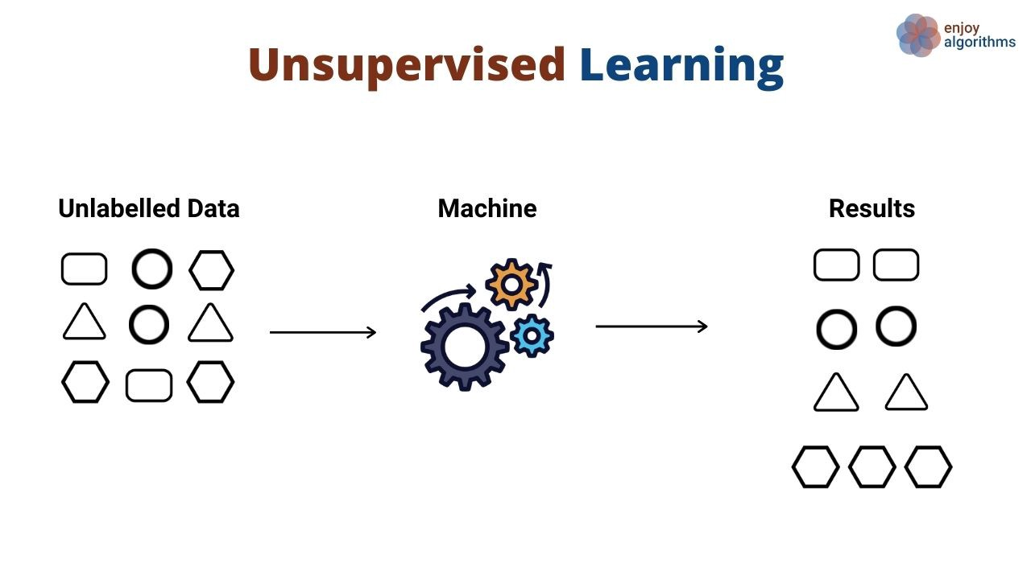

Slide 14
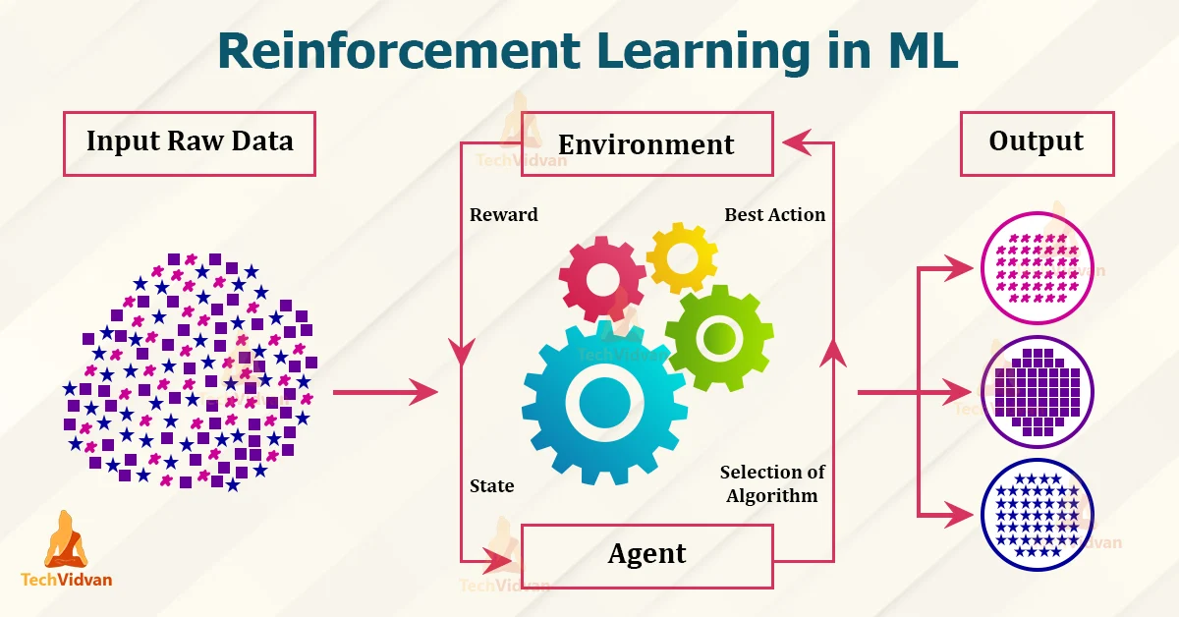

Slide 15
What is Regression and Classification in ML ?
3

Slide 16
Difference between Regression and Classification
Regression
A regression algorithm can predict a discrete value which is in the form of an integer quantity.
Example : Predicting the price of a house given house features.
Classification
A classification algorithm can predict a continuous value if it is in the form of a class label probability.
Example : Email spam detector.

Slide 17
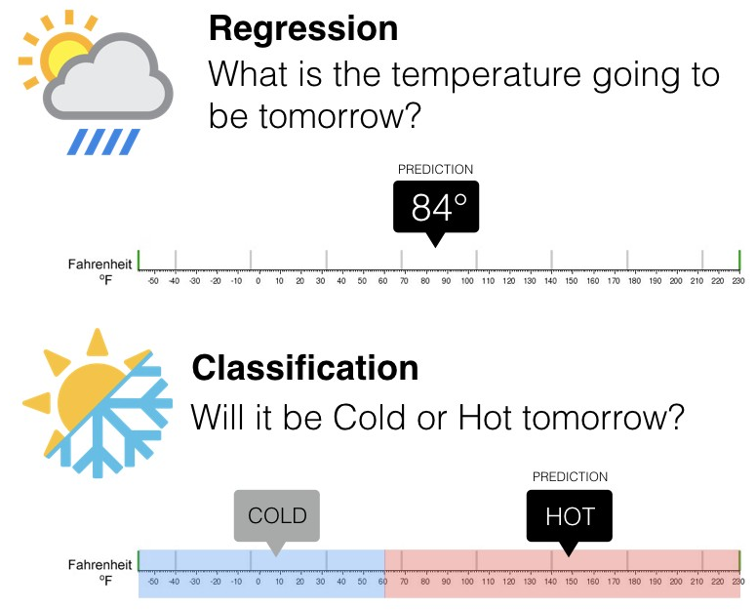

Slide 18
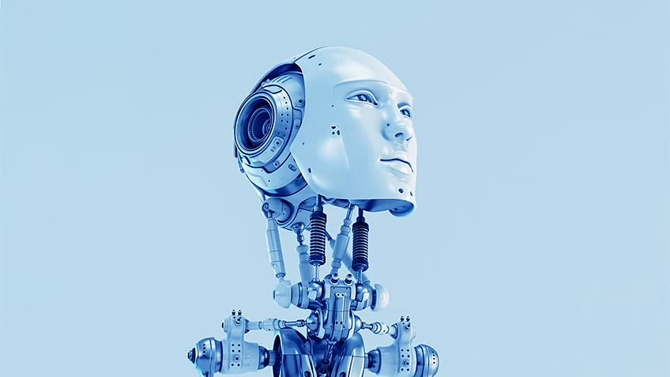
WANT BIG IMPACT?
use AI
“Predicting the future is’nt Magic, It’s Artificial Intelligence.”

Slide 19
Top 10 countries leading in AI race :
7.NORWAY
4. CANADA
8.SWEDEN
5.RUSSIA
3. UK
9.FRANCE
6.GERMANY
2.USA
1. CHINA
10.INDIA

Slide 20
Explain different Machine Learning algorithms.
7

Slide 21
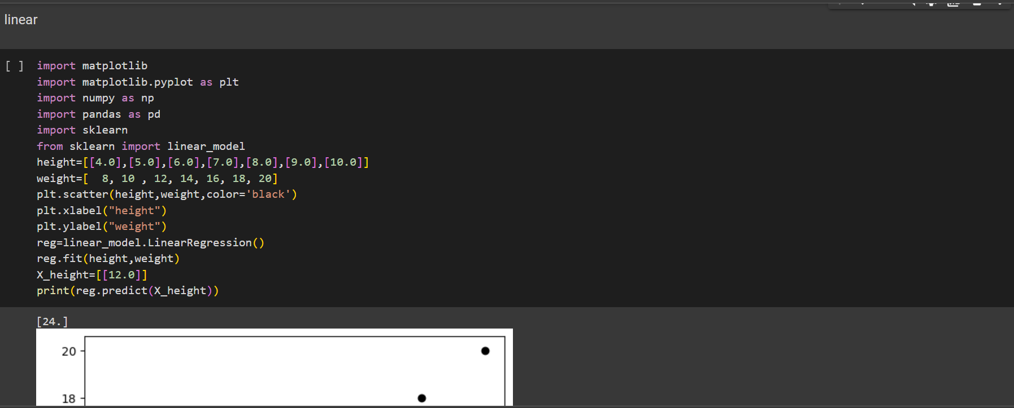
Linear Regression

Slide 22
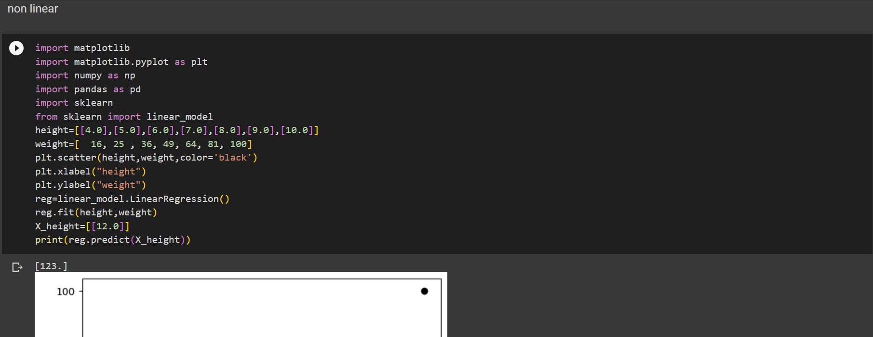
2. Non Linear

Slide 23
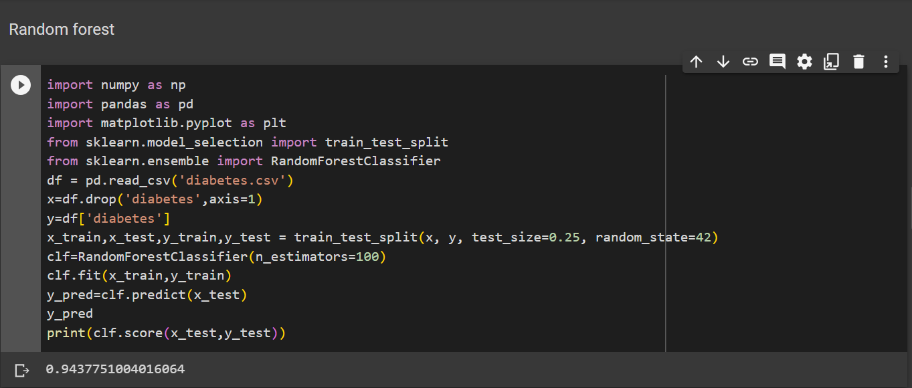
3. Random Forest

Slide 24
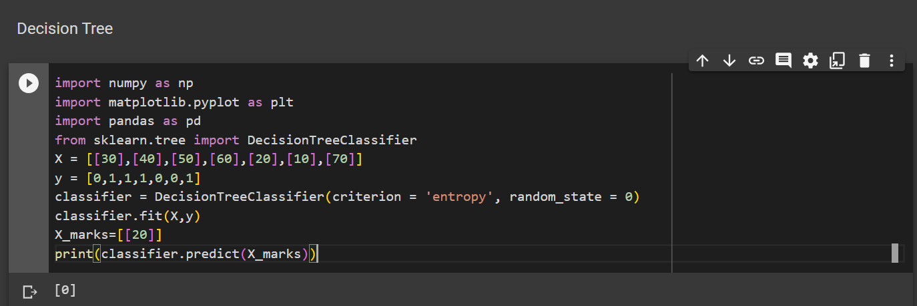
4. Decision Tree

Slide 25
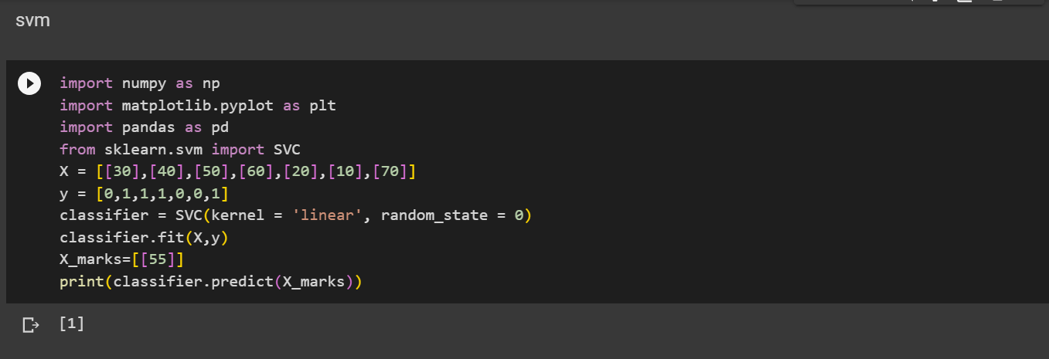
5. Support Vector Machine

Slide 26
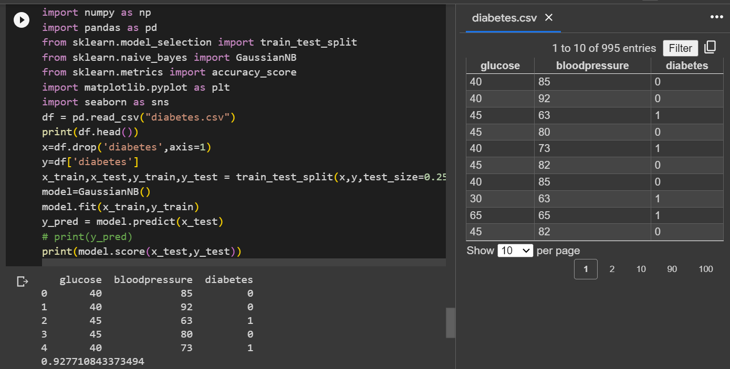
4. Naive Bayes Algorithm

Slide 27
Thanks!
ANY QUESTIONS?
You can find me at
Mustafah.bsc22@rvu.edu.in

